Slide 1
Markov Decision Process

Slide 2
Outline
Exploration vs Exploitation
Regret
Explore Only
Exploit Only
Epsilon Greedy
Optimistic Initialization
Upper Confidence Bound

Slide 3
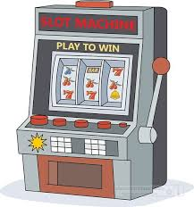
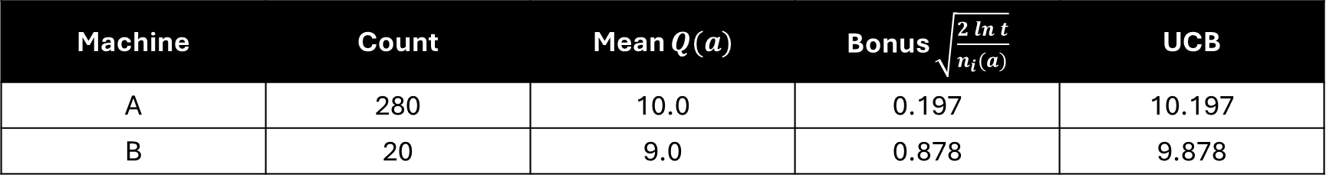

A
B
$$t=300$$
Machine | Count | Mean $Q(a)$ | Bonus $\sqrt{\frac{2\ln{t}}{n_{i}(a)}}$ | UCB
A | 280 | 10.0 | 0.197 | 10.197
B | 20 | 9.0 | 0.878 | 9.878
This is because we played machine A more than machine B.

